Slide 1
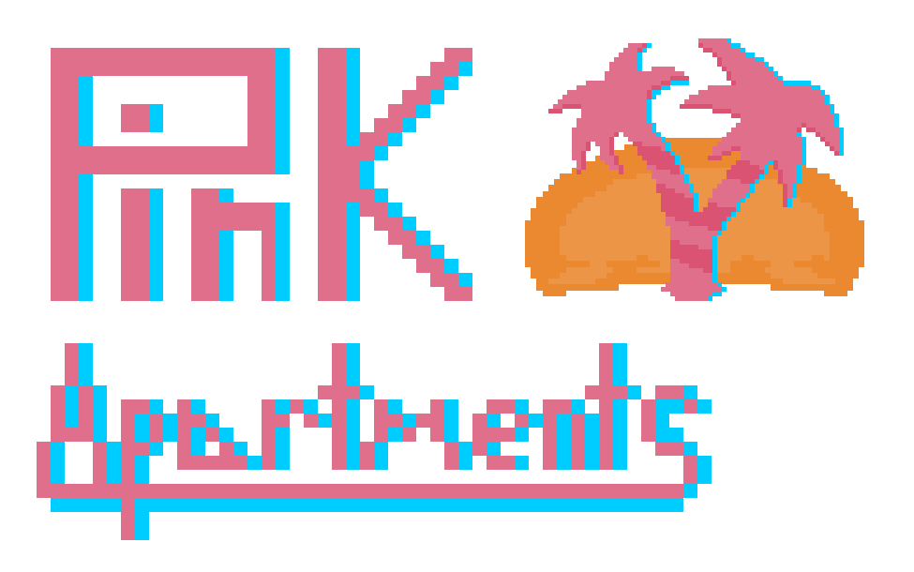
Jenna Lovett, Troy Purvis, Tyler Hodzen

Slide 2
Project Narrative
Simulates an administrative-focused database for an apartment complex
Includes data regarding apartments, contracts, residents, etc.

Slide 3
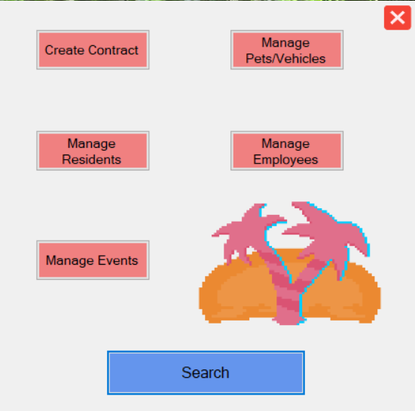
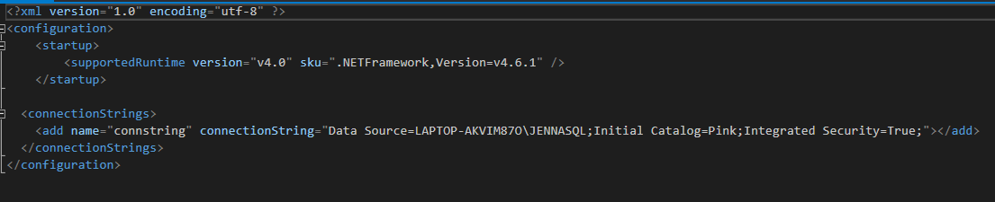
Software Stack
MS SQL Server + Visual Studio (C#/VB) = Windows Form Application

Slide 4
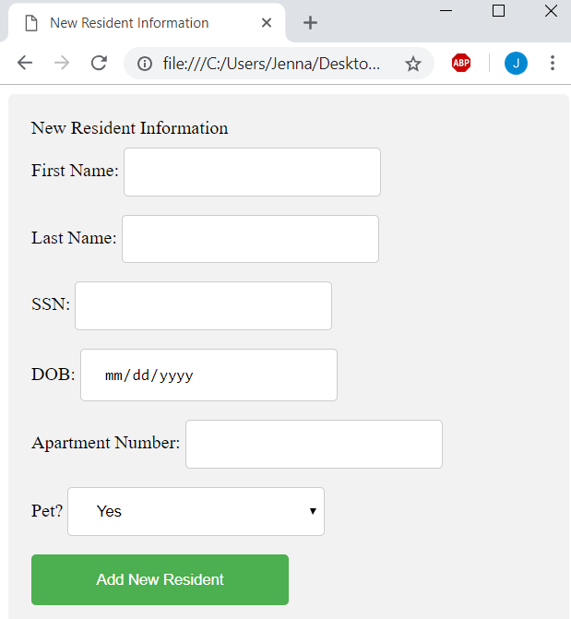
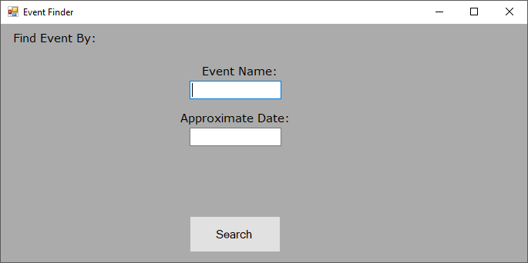
Mock UI

Slide 5
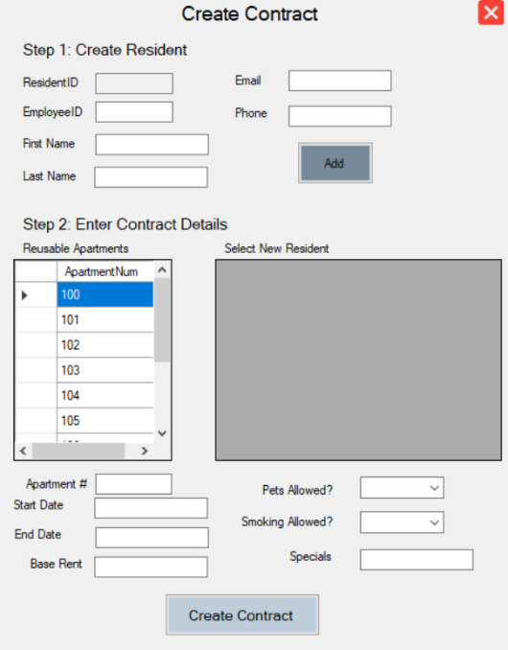
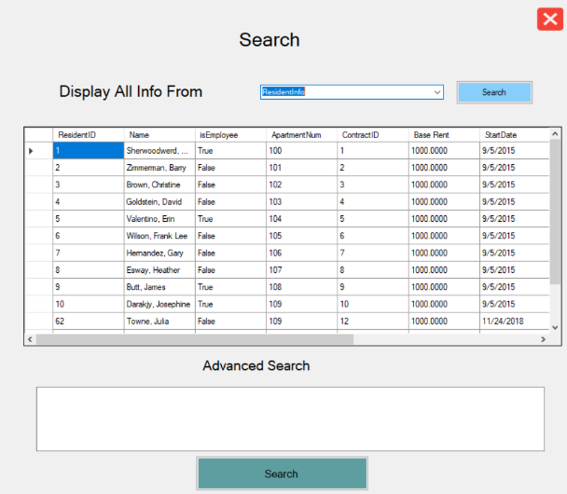

Slide 6
